Slide 1


Vision-Voice: Smart Assistant for the Visually Impaired
Team Members
Guide
P. Sai Pavan, T. Vaibhavi, N. Mallesh
P. Swathi
Date
March 24, 2025

Slide 2
Agenda
Project Overview
Implementation Goals
System Architecture and Design
Workflow/Methodology
Results
Future Scope
Conclusion

Slide 3
Project Overview
AI-Powered Object Detection:
Voice Navigation System:
SOS Emergency Alert System
Utilizes YOLO-V8 and EfficientNet to detect objects in real-time using a web-application. OpenCV processes the video feed, and Google Text-to-Speech (TTS) provides instant audio feedback, enhancing indoor navigation for visually impaired users.
The Android app integrates Google Voice Recognition and Google Maps API to provide voice-based navigation. Users state their destination, and step-by-step audio guidance ensures independent outdoor mobility with optional obstacle alerts and offline navigation support.
A dedicated SOS button enables users to send their live location and an emergency message to selected contacts. Features include auto-calling emergency contacts, live location sharing, and potential fall detection for enhanced safety and rapid response.

Slide 4




Implementation Goals
Real-Time Object Detection:
Seamless Voice Navigation
Reliable SOS Emergency System
User-Friendly and Accessible Design
Ensure fast and accurate object recognition using YOLO-V8 and EfficientNet. The system should provide instant audio feedback through Google Text-to-Speech (TTS) for seamless interaction in indoor environments.
Integrate Google Voice Recognition and Google Maps API to offer hands-free navigation. The system should deliver real-time step-by-step directions with obstacle avoidance to assist visually impaired users.
Develop a quick-access SOS feature that sends live location and emergency alerts to pre-selected contacts. Ensure low-latency message delivery and possible fall detection integration for enhanced user safety.
Create an intuitive UI for both the web and mobile applications, ensuring high accessibility with voice commands, simple navigation, and responsive design to cater to users with visual impairments.

Slide 5
System Architecture and Design
1️⃣ Modular Architecture
The system is divided into two main components: a web application (Flask-based) for object detection and a mobile application (Android-based) for navigation and SOS alerts. Each module operates independently while communicating efficiently.
2️⃣ Machine Learning Integration
The backend leverages YOLO-V8 and EfficientNet for real-time object detection. OpenCV processes camera input, while Google TTS converts recognized objects into audio feedback for visually impaired users.
3️⃣ Cloud and API Connectivity
Google Voice Recognition API processes user commands, while Google Maps API enables step-by-step navigation. The SOS system sends emergency alerts with live location via SMS or cloud messaging services.
4️⃣ User Interaction and Accessibility
The system employs voice commands and audio responses for an intuitive, hands-free experience. The UI is designed with high-contrast elements and accessibility features to accommodate visually impaired users.
5️⃣ Efficient Data Handling
The Flask server handles object detection requests and image processing, while the Android app manages navigation and emergency alerts, ensuring optimized performance and low latency across both platforms.

Slide 6
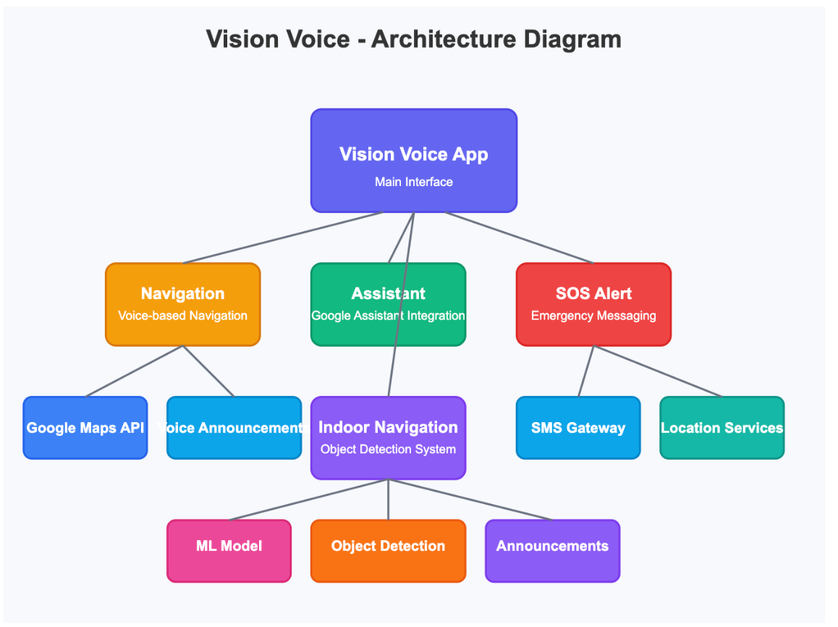
Architecture Diagram

Slide 7

Workflow
Image Acquisition & Processing
The web application captures real-time images using OpenCV.
These images are processed using YOLO-V8 and EfficientNet for accurate object detection.
Object Recognition & Speech Output
Detected objects are identified and classified.
Google Text-to-Speech (TTS) provides immediate audio feedback with object names and positions.
Navigation & Voice Command Integration
The Android app records voice inputs using Google Voice Recognition.
The extracted destination is processed and sent to Google Maps for real-time navigation.
Emergency SOS System
The user can press an SOS button to send emergency alerts.
The system shares the current location and a predefined message with selected contacts for immediate assistance.

Slide 8

Work Completed
Model Training, Object Detection
Web Application Development
Android App Implementation
System Integration & Testing
Trained YOLO-V8 and EfficientNet for indoor object detection.
Built a Flask-based web application to handle object detection.
Developed voice-based navigation using Google Voice Recognition and Google Maps.
Successfully tested object detection, speech output, and navigation features.
Integrated OpenCV for real-time image capture and processing.
Implemented Google Text-to-Speech (TTS) for audio feedback to users.
Integrated an SOS emergency alert system to send real-time location updates.
Conducted real-world testing to ensure system reliability and accuracy.

Slide 9

Results
1️⃣ Accurate Object Detection
2️⃣Efficient Navigation ,Emergency Response
3️⃣ User-Friendly & Reliable System
The YOLO-V8 model successfully detects and identifies objects in real-time with high accuracy, aiding visually impaired users in recognizing their surroundings.
The Android app delivers precise, step-by-step voice navigation using Google Maps, while the SOS alert system ensures user safety by instantly notifying emergency contacts.
The combined web and mobile applications create a smooth, AI-powered assistive tool, improving mobility, autonomy, and security for visually impaired users.

Slide 10
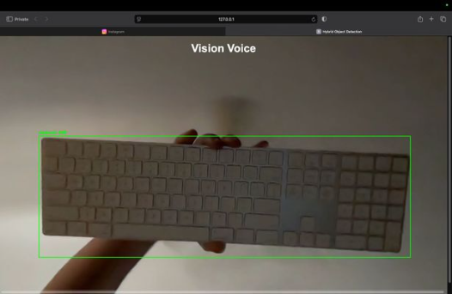
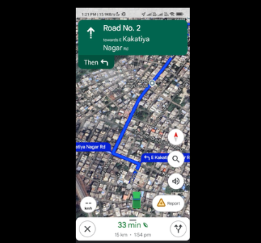
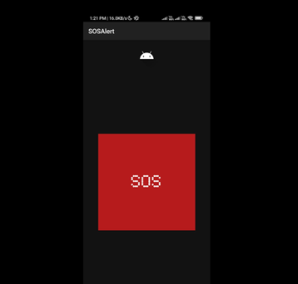
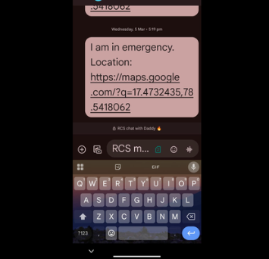
Implementation/Screenshots

Slide 11

Future Scope
1️⃣ Edge Computing for Faster Processing
2️⃣ Multi-Language & Voice Personalization
Implementing on-device AI processing can reduce latency and improve real-time object detection, making the system more efficient without relying on cloud services.
Expanding language support and enabling customized voice options will make the system more inclusive and adaptable for users from different regions.
3️⃣ Integration with Wearable Devices
4️⃣ Advanced AI & Scene Understanding
Developing compatibility with smart glasses or wearable devices can offer hands-free assistance, enhancing convenience and usability for visually impaired users.
Enhancing YOLO and AI models to recognize complex scenes, obstacles, and contextual information will provide better navigation assistance, ensuring a safer user experience.

Slide 12
Conclusion
1️⃣ AI-Powered Assistance
2️⃣ Seamless User Experience
3️⃣ Future Scope & Impact
The project successfully integrates AI-driven object detection and voice navigation, enhancing mobility and independence for visually impaired users through real-time guidance and audio feedback.
By combining Flask, OpenCV, YOLO-V8, and Google APIs, the system delivers an intuitive, accessible, and responsive solution tailored to user needs.
The project lays the foundation for further enhancements, such as edge computing for faster processing, multi-language support, and enhanced emergency features, making assistive technology more inclusive and efficient.

Slide 13


